Slide 1

Pattern Recognition
COMP3045
HITSZ, 2023

Slide 2

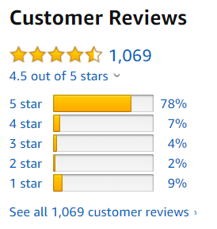
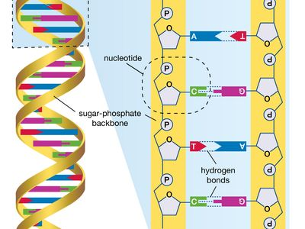
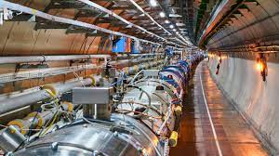
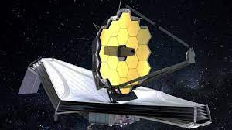
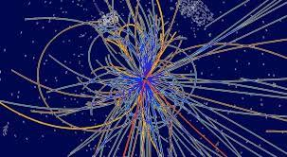
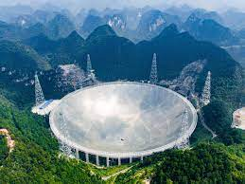
Motivation – Era of Big Data
We are collecting and storing data at an unprecedented rate.
Examples:
News articles, blog posts, videos
Purchase history, movie/book rating
Gene sequencing data
High-energy particle collider
Astronomical survey
Many valuable information in the data.
But impossible for humans to process manually…
Five hundred meter Aperture Spherical Telescope (Tianyan), located in Guizhou

Slide 3
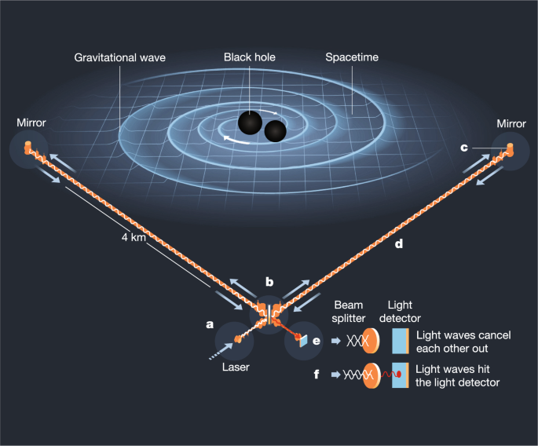
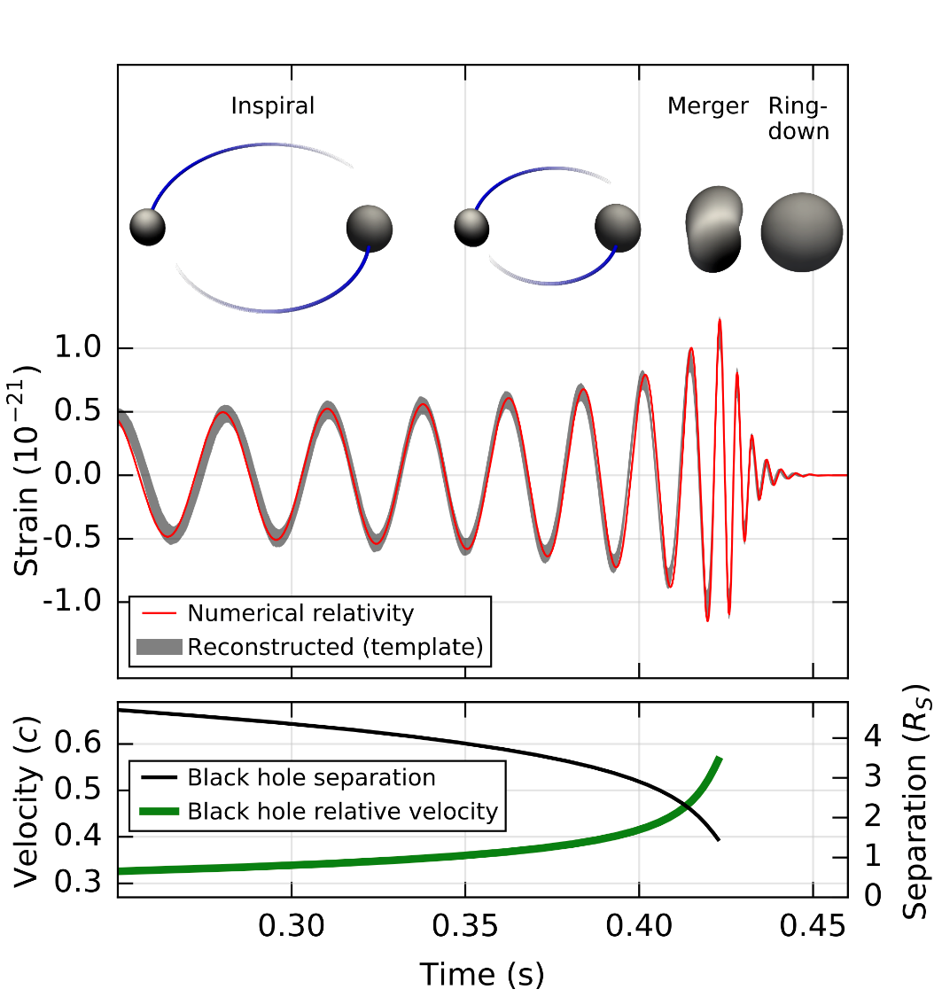
Motivation – Era of Big Data
Need techniques to recognize patterns automatically.
Example of gravitational wave detection:
Template matching of patterns to detect the signal.
For more complex tasks and bigger data sets, machine learning methods are very useful to detect patterns in data and make predictions.
Notes:
Machine learning has a broader sense than pattern recognition (e.g., ML also includes methods for symbolic reasoning).
But in the last decade, ML is most successful in pattern recognition tasks.

Slide 4

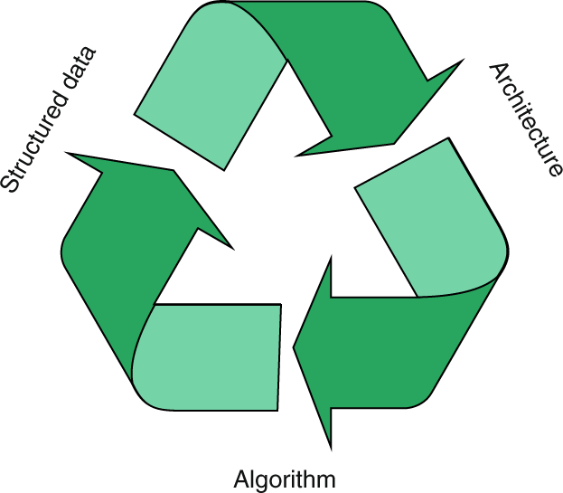
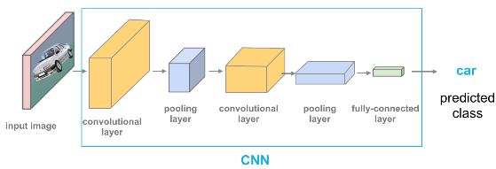

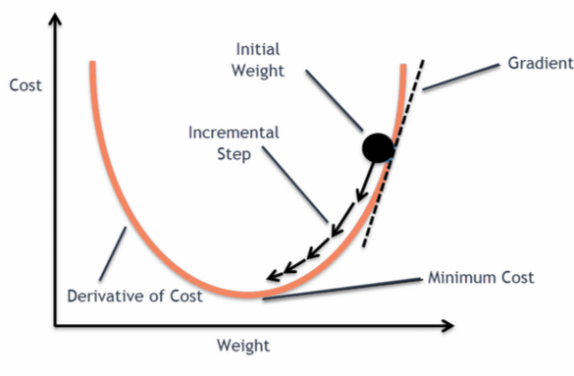

Scope of The Course
We aim to cover some advanced methods of machine learning and their applications in pattern recognition.
A machine learning pipeline generally has three parts:
Data
Model
Algorithm
Main focus of this course
Objective function
Probabilistic model
…
Optimization
Inference
…
$$⇒$$

Slide 5
Scope of The Course – 4 Major Topics
Brief introduction to convex optimization
Sparse models
Sparse signal recovery (compressed sensing, matrix completion)
Algorithms (convex opt, SDP, proximal methods, ADMM, etc)
Robust PCA, Sparse coding, …
Probabilistic graphical models (PGMs)
Belief networks, Markov random field, latent Dirichlet allocation
Learning and inference in PGMs, message-passing algorithms
Pattern recognition in graph signals
Community detection, semi-supervised learning
Graph signal processing, graph neural networks
Gaussian process (GP)
Kernel methods, GP for regression
Bayesian optimization, relation to neural networks (if time is permitted)
Resource:
The lecture slides are more or less self-contained.
No canonical textbook covers all 4 parts. We will give some references when we come to each topic.

Slide 6
Scope of The Course – 4 Major Topics
0. Brief introduction to convex optimization
Sparse models
Probabilistic graphical models (GMs)
Pattern recognition in graph signals
Gaussian process (GP)
All of them start from a very simple principle.
Some topics are a bit involved and require some mathematical derivations.
But at the end of the day, you will (usually) obtain a simple and elegant algorithm for solving a complex task!
The best way to learn them is to go through the math to improve your understanding.
If you are not interested in the math, it is still useful to know what the model is doing, how to apply it, and what are the assumptions behind.
Some contents will not be covered in the lecture.
They are provided for consistency of the topic. Learn according to your interests.

Slide 7
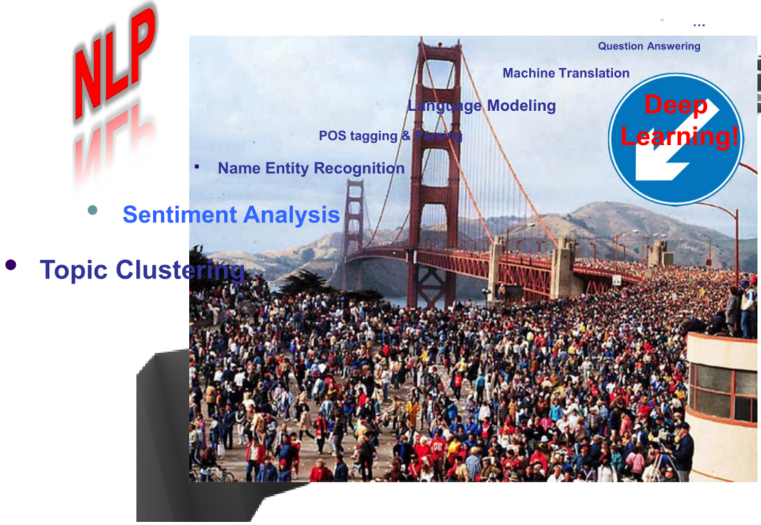
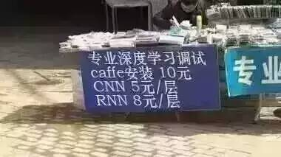
Scope of The Course
But perhaps the bigger question is, why these methods?
You may learnt from elsewhere that, “deep learning is replacing everything”.
The topics that we just mentioned seems already to be the traditional methods.
The answers to this is a-few-fold.
Deep learning is usually a sub-optimal choice with small data, or when a white-box model is preferred. Vanilla deep learning also does not deal with uncertainty.
Moreover…
From Prof. Eric Xing

Slide 8

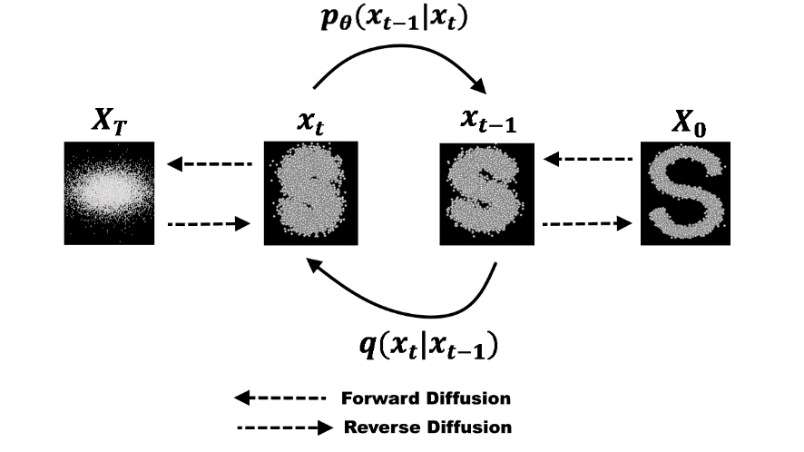
Scope of The Course
On the other hand, combining deep learning with some old ideas may help to discover something completely new (we will discuss a few such cases further in this course).
Take the very popular diffusion model right now as an example:
It links to an idea from nonequilibrium physics.
[“Deep Unsupervised Learning using Nonequilibrium Thermodynamics”, Jascha Sohl-Dickstein, et al., 2015]
A large room to explore “deep learning + something”.
Some good “traditional” ideas will likely make their renaissance at some point.
Mastering the principles can help you to go deeper and create new ideas.
Notes:
Deep learning alone is less excited.
Large room to explore Deep learning + something.

Slide 9
Logistic
3 homework assignments: 60% of grade
Theoretical derivation + some programming
To be submitted individually
1 computer experiment + 1 mini project: 20%
A brief project report summarizing your findings of the experiment. It could be
Scientific discovery of the data from the pattern recognition method
An improvement for the method
Some tricky implementation details you found essential or non-intuitive
…
Submission in group (max size = 4) is allowed
1 computer experiment + 1 mini project: 20%
Apply one method (or more) from the course to your favorite data
Submit (a brief project report) or (a poster + a video up to 5 min)
Submission in group (max size = 4) is allowed

Slide 10
Have fun!

Slide 11
Convex Optimization Essential

Slide 12
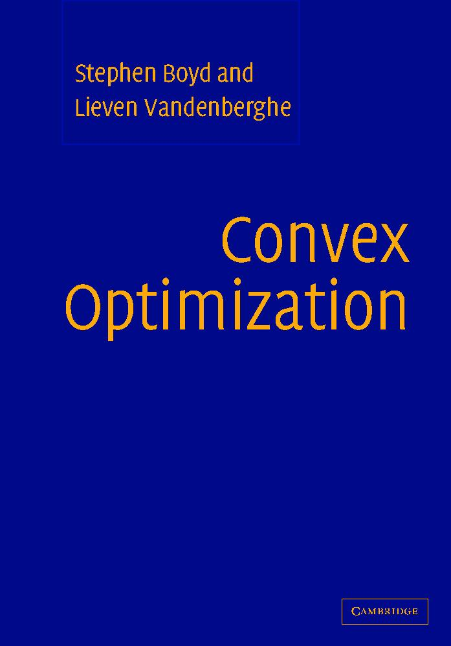
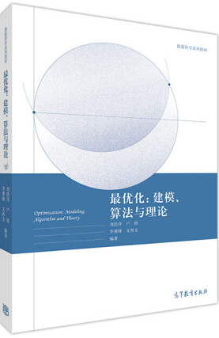
Convex Optimization (A very quick overview)
Unconstrained optimization
Linear programming problem
Convex optimization and concept of duality
Interior point method
Semidefinite programming
Main references
Lectures by Prof. Stephen Boyd (Stanford)
Materials in: https://web.stanford.edu/~boyd/cvxbook/
《最优化：建模、算法与理论》, 2020, 刘浩洋等 (北京大学 文再文教授组)
https://bicmr.pku.edu.cn/~wenzw/optbook.html

Slide 13
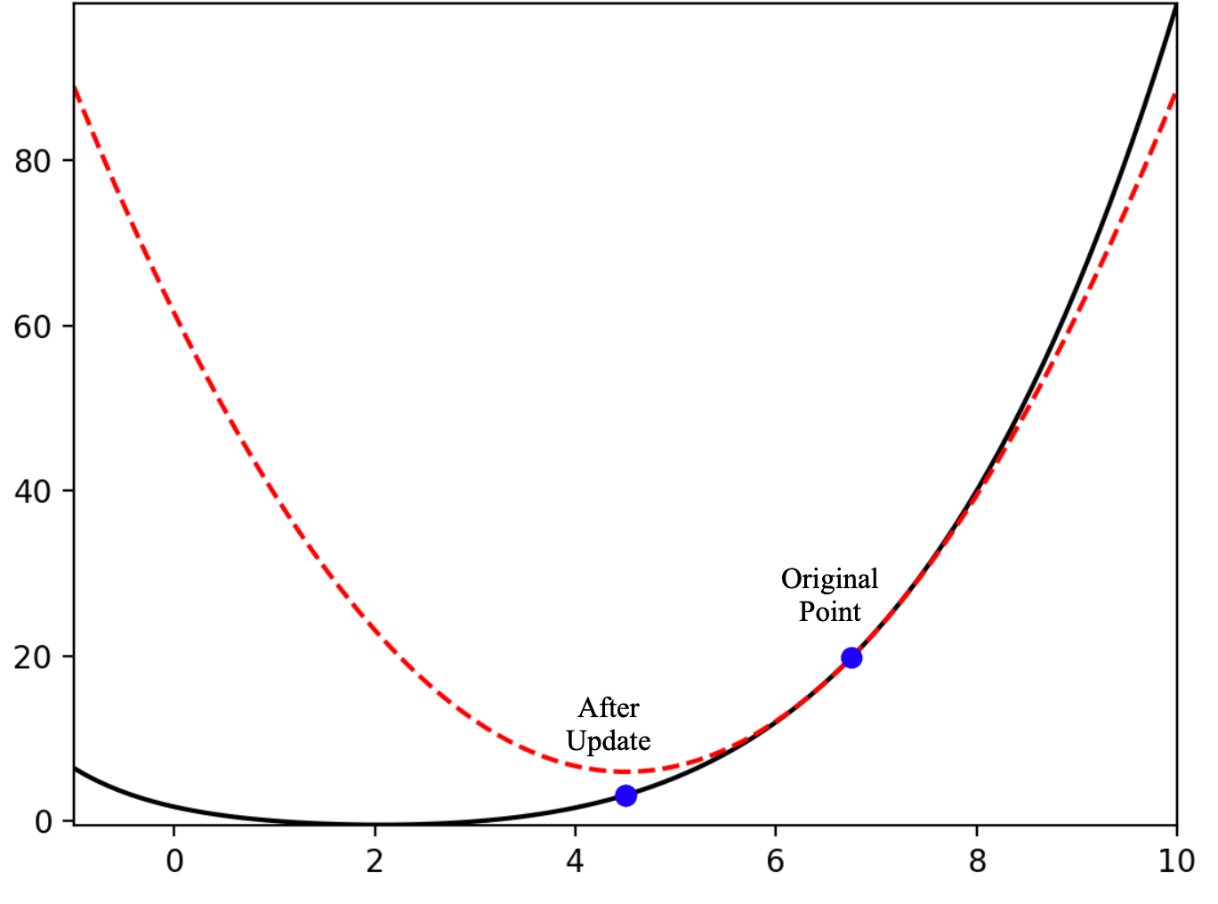
Unconstrained Optimization of Smooth Function
Problem:
Descent method:
∆x is the search direction; t is the step size
Gradient descent:
Newton’s method:
Necessary condition for optimality:
Gradient descent
Newton’s method

Slide 14
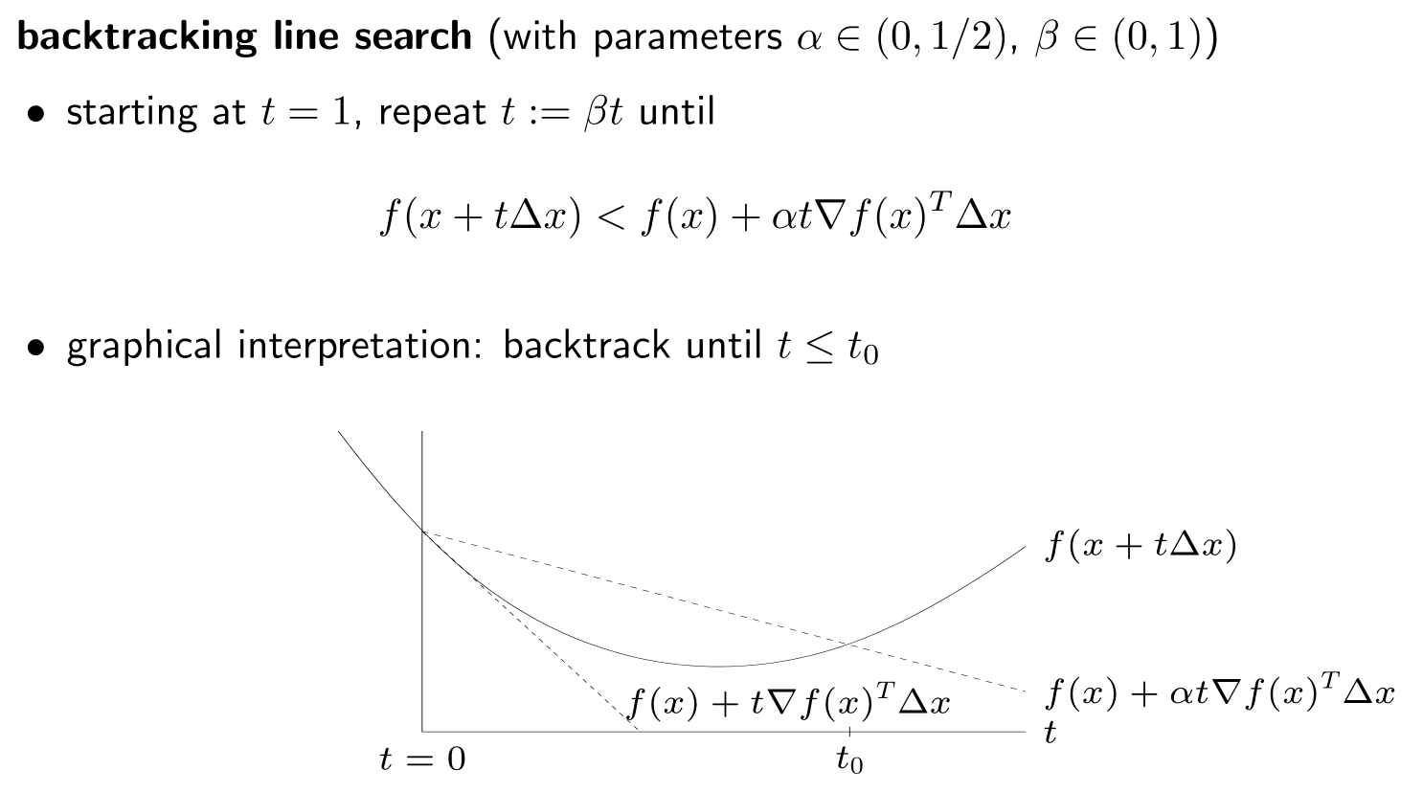
Line Search to Determine Step Size
Idea: shorten the step size until a pre-determined level of decrement of the objective function is met.

Slide 15
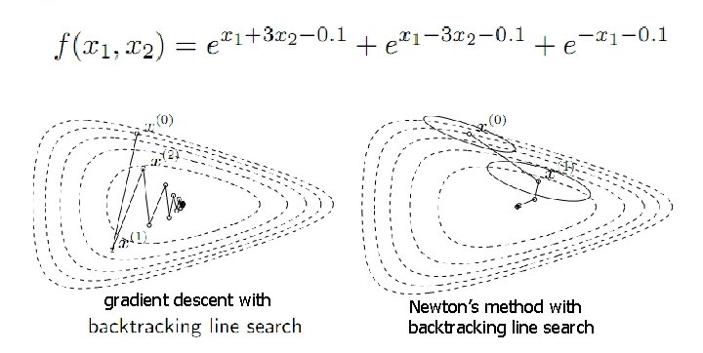
Example
fewer iteration steps
but more computations (for computing the Hessian) per iteration; this becomes a bottleneck for large scale problems.

Slide 16
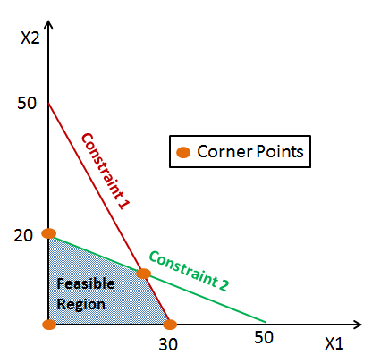
Linear Programming and Dual Problem
We learnt that linear programming has two equivalent forms
Primal problem
Dual problem
Use of dual problem
Possibly simpler to solve
Sensitivity analysis (e.g., “shadow” price)
Sometimes has an interesting interpretation
The dual problem can be derived from Lagrange duality.
Lagrange duality applies to the more general convex optimization problem.

Slide 17
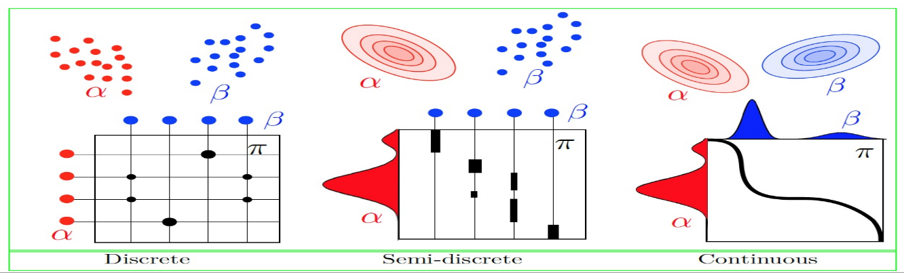
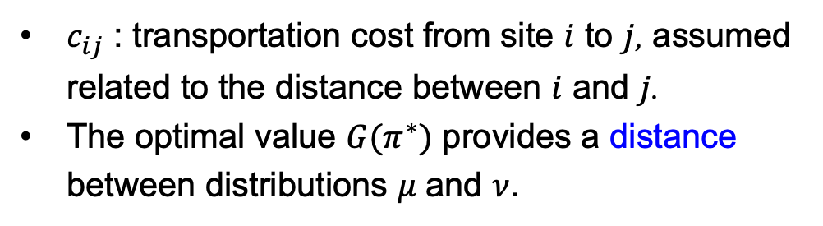
Example - Optimal Transport
Primal problem
$c_{ij}$ : transportation cost from site $i$ to $j$, assumed related to the distance between $i$ and $j$.
The optimal value $G(π^{∗})$ provides a distance between distributions $μ$ and $ν$.

Slide 18
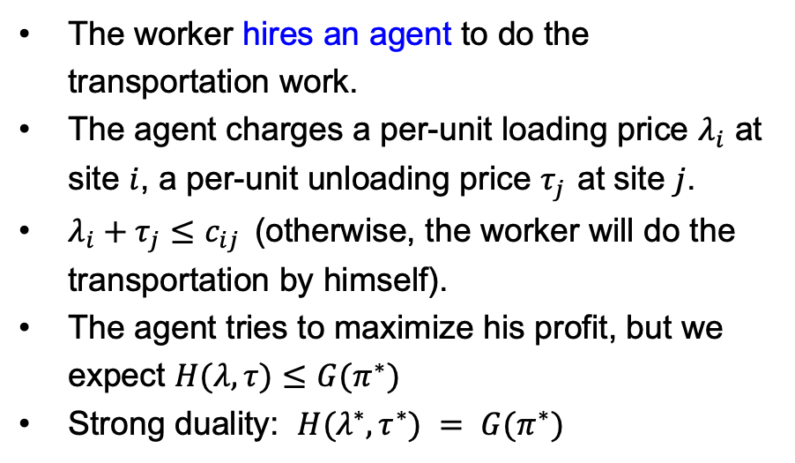
Example - Optimal Transport
Primal problem
Dual problem
The worker hires an agent to do the transportation work.
The agent charges a per-unit loading price $λ_{i}$ at site $i$, a per-unit unloading price $τ_{j}$ at site $j$.
$λ_{i}+τ_{j}≤c_{ij}$ (otherwise, the worker will do the transportation by himself).
The agent tries to maximize his profit, but we expect $H(λ, τ)≤G(π^{∗})$
Strong duality: $H(λ^{∗},τ^{∗}) = G(π^{∗})$
The worker tries to transport the mass by himself using the most economic way, with a cost G(π*).

Slide 19
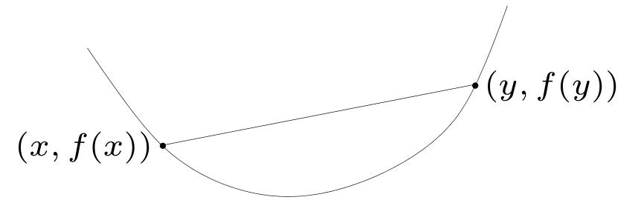
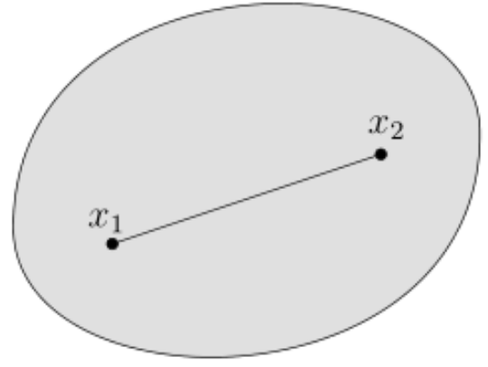
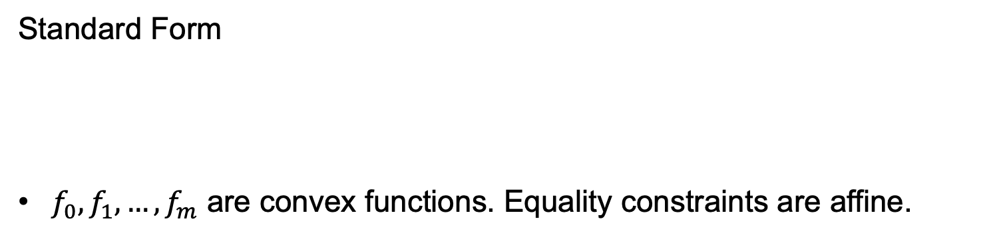
Convex Optimization
Standard Form
$f_{0}, f_{1}, …,f_{m}$ are convex functions. Equality constraints are affine.
convex function
convex set
convex function f
convex set C

Slide 20

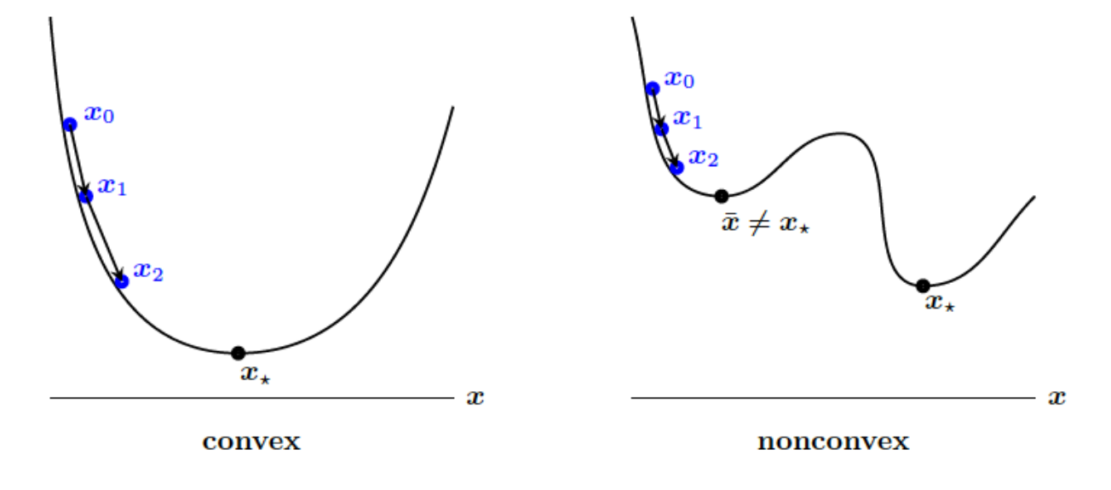
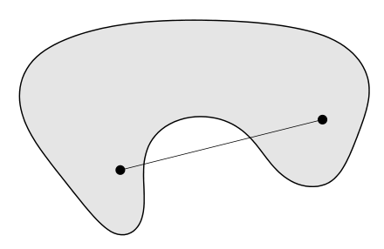
Why Convex Optimization
convex set
nonconvex set
The geometry is “nice” for local methods
A locally optimal point of a convex problem is globally optimal.
Many classes of convex optimization admits polynomial time algorithms.

Slide 21
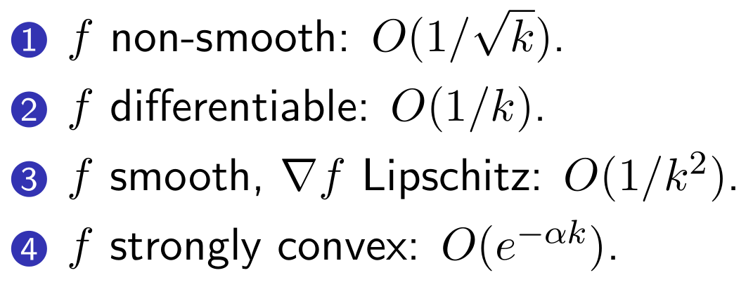
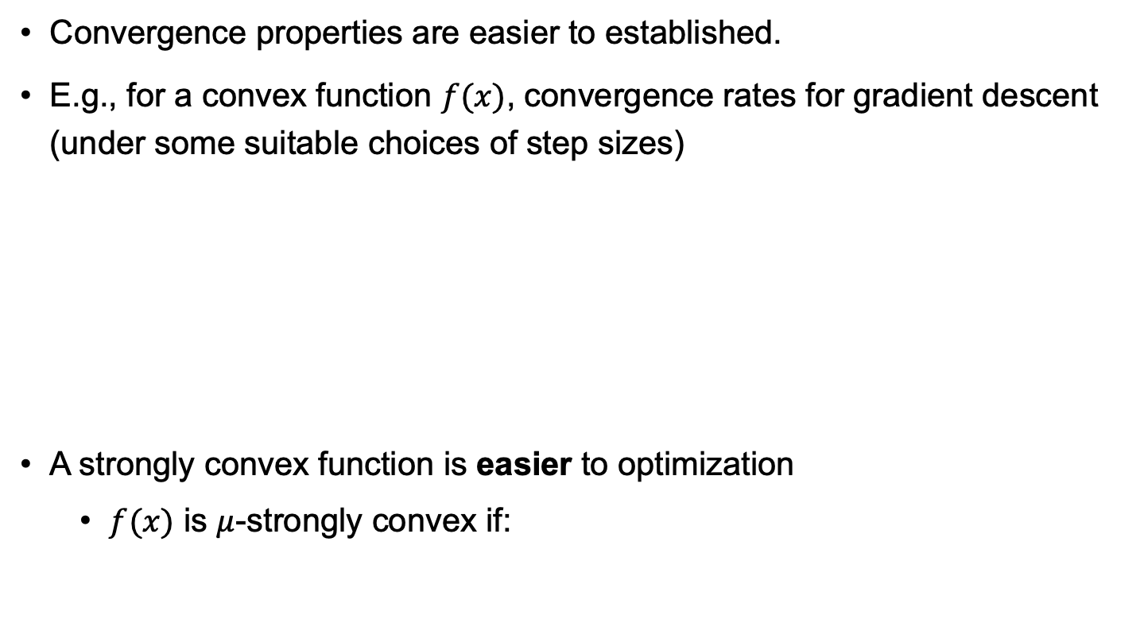
Why Convex Optimization
Convergence properties are easier to established.
E.g., for a convex function $f(x)$, convergence rates for gradient descent (under some suitable choices of step sizes)
A strongly convex function is easier to optimization
$f(x)$ is $μ$-strongly convex if:
Notes:
Counter example of strongly-convex: linear function.

Slide 22
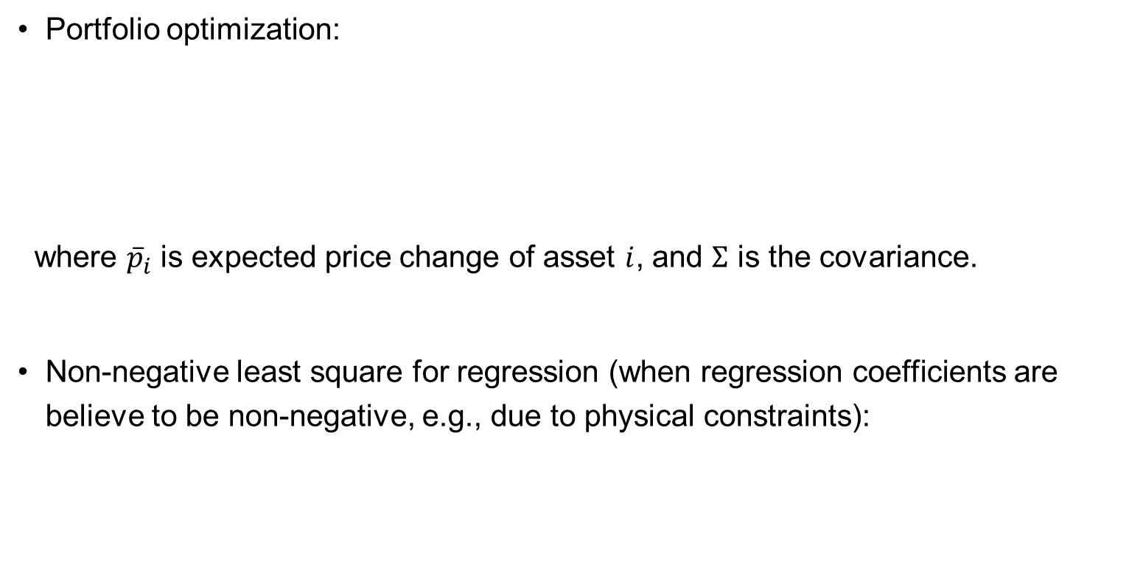
Examples
Portfolio optimization:
where ${\overline{p}}_{i}$ is expected price change of asset $i$, and $Σ$ is the covariance.
Non-negative least square for regression (when regression coefficients are believe to be non-negative, e.g., due to physical constraints):

Slide 23
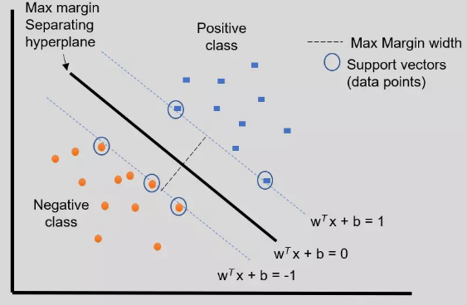
Examples
Support vector machines (SVM) (Separable case):

Slide 24
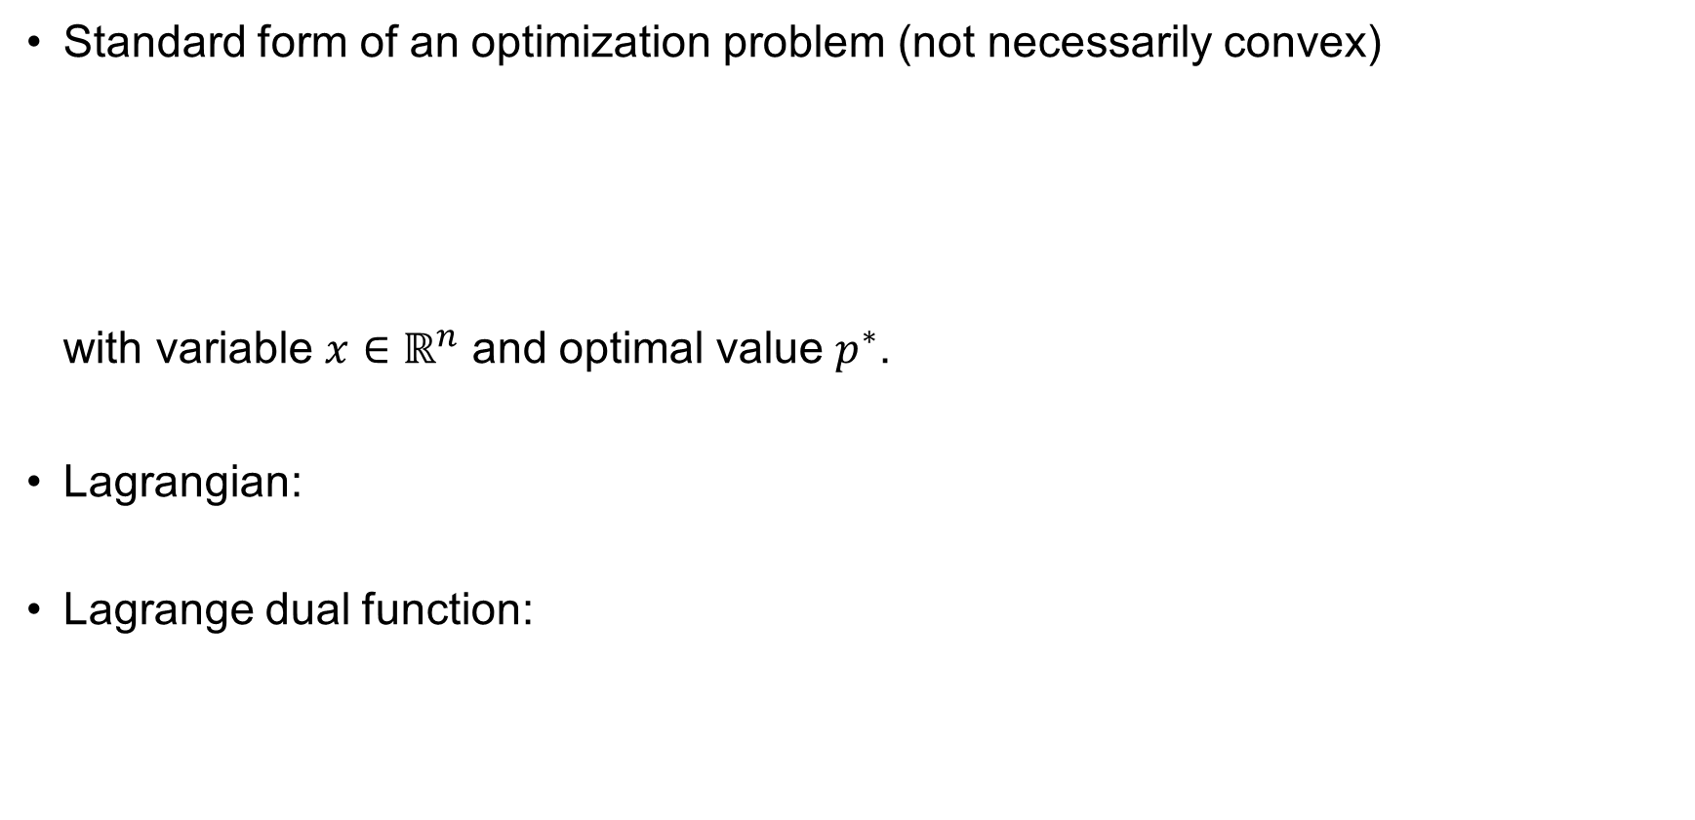
Lagrange Duality
Standard form of an optimization problem (not necessarily convex)
with variable $x∈ℝ^{n}$ and optimal value $p^{∗}$.
Lagrangian:
Lagrange dual function:

Slide 25
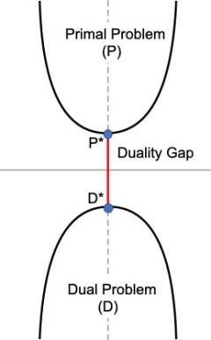
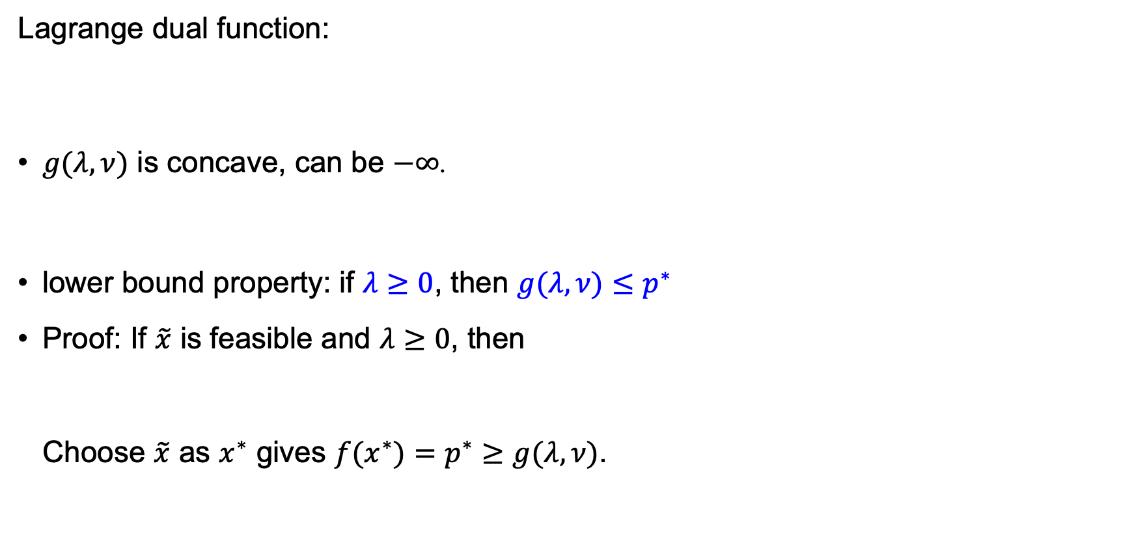
Lagrange Duality (Important)
Lagrange dual function:
$g(λ, ν)$ is concave, can be $−∞$.
lower bound property: if $λ≥0$, then $g(λ, ν)≤p^{∗}$
Proof: If $\tilde{x}$ is feasible and $λ≥0$, then
Choose $\tilde{x}$ as $x^{∗}$ gives $f(x^{∗})=p^{∗}≥g(λ, ν)$.

Slide 26
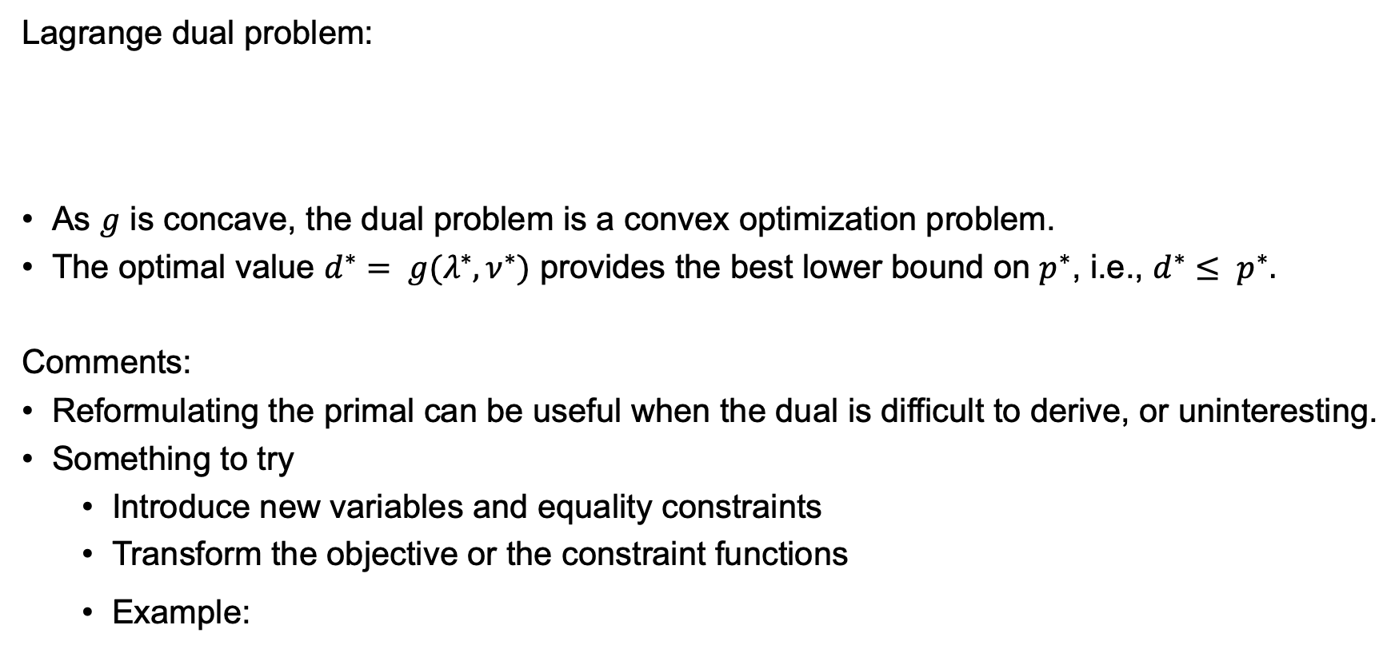
Dual Problem
Lagrange dual problem:
As $g$ is concave, the dual problem is a convex optimization problem.
The optimal value $d^{∗}= g(λ^{∗}, ν^{∗})$ provides the best lower bound on $p^{∗}$, i.e., $d^{∗}≤ p^{∗}.$
Comments:
Reformulating the primal can be useful when the dual is difficult to derive, or uninteresting.
Something to try
Introduce new variables and equality constraints
Transform the objective or the constraint functions
Example:

Slide 27
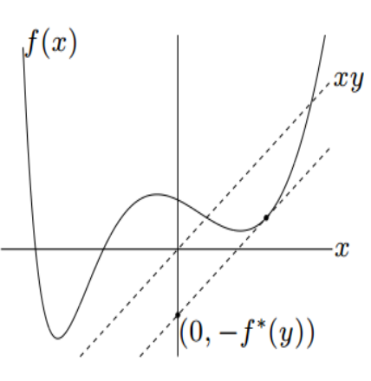
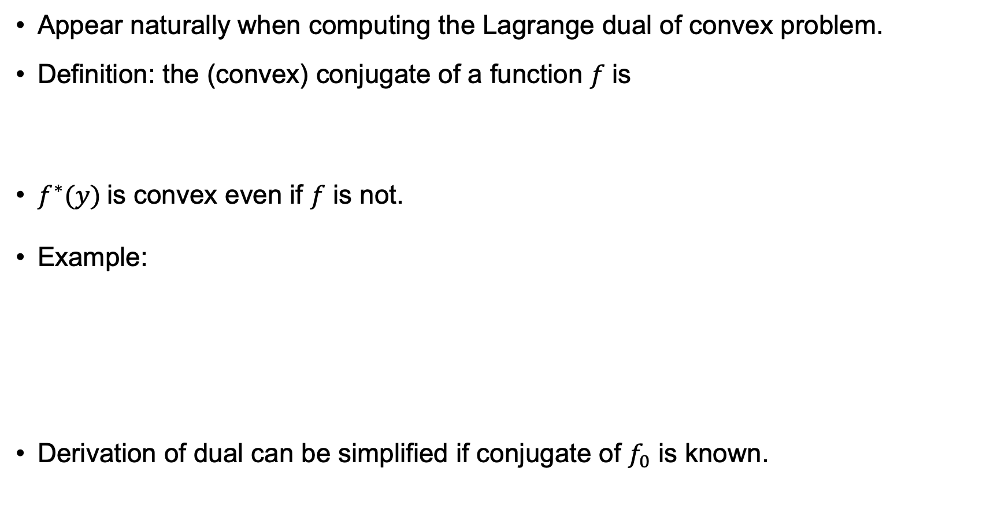
Convex Conjugate (optional)
Appear naturally when computing the Lagrange dual of convex problem.
Definition: the (convex) conjugate of a function $f$ is
$f^{∗}(y)$is convex even if $f$ is not.
Example:
Derivation of dual can be simplified if conjugate of $f_{0}$ is known.
Dual function:

Slide 28
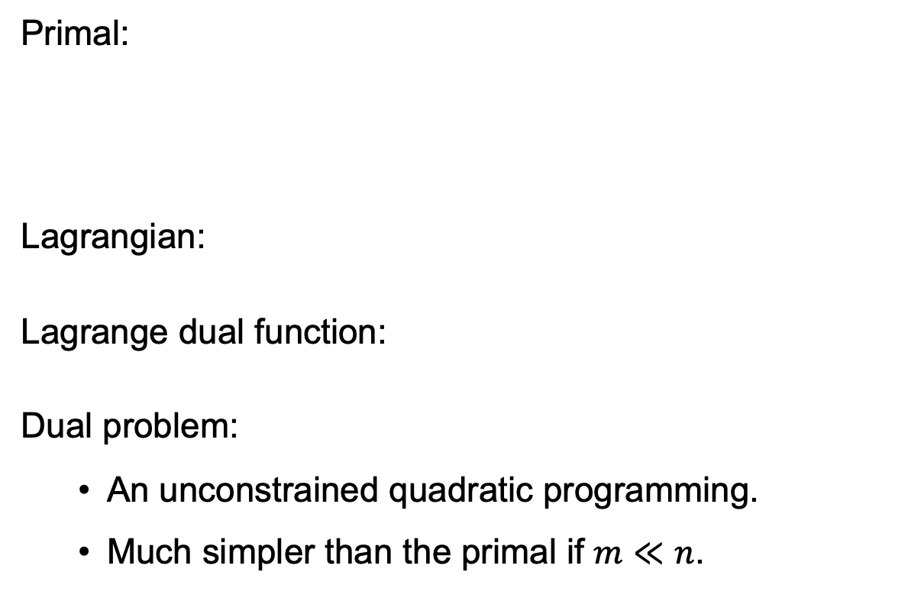
Dual Problem – Example of QP
Primal:
Lagrangian:
Lagrange dual function:
Dual problem:
An unconstrained quadratic programming.
Much simpler than the primal if $m≪n$.

Slide 29
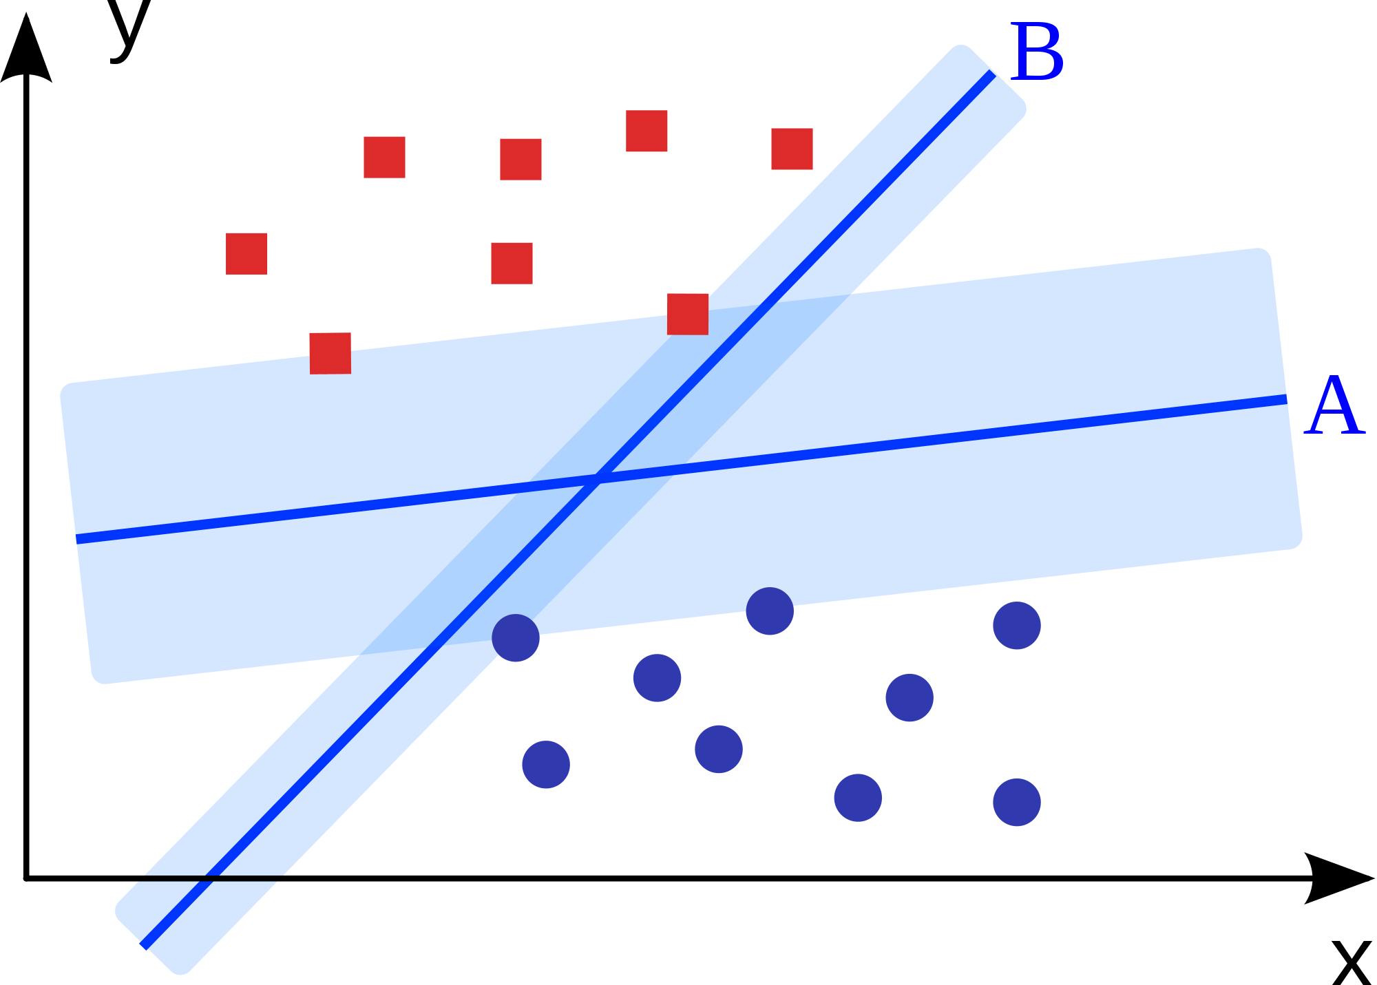
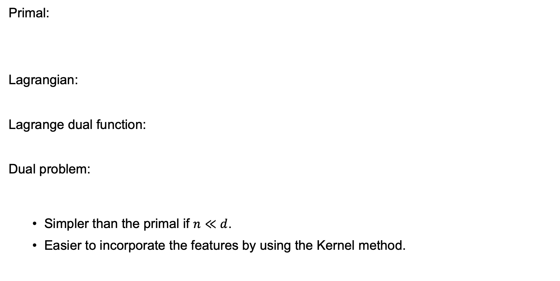
Dual Problem – Example of SVM
Primal:
Lagrangian:
Lagrange dual function:
Dual problem:
Simpler than the primal if $n≪d$.
Easier to incorporate the features by using the Kernel method.
😃

Slide 30
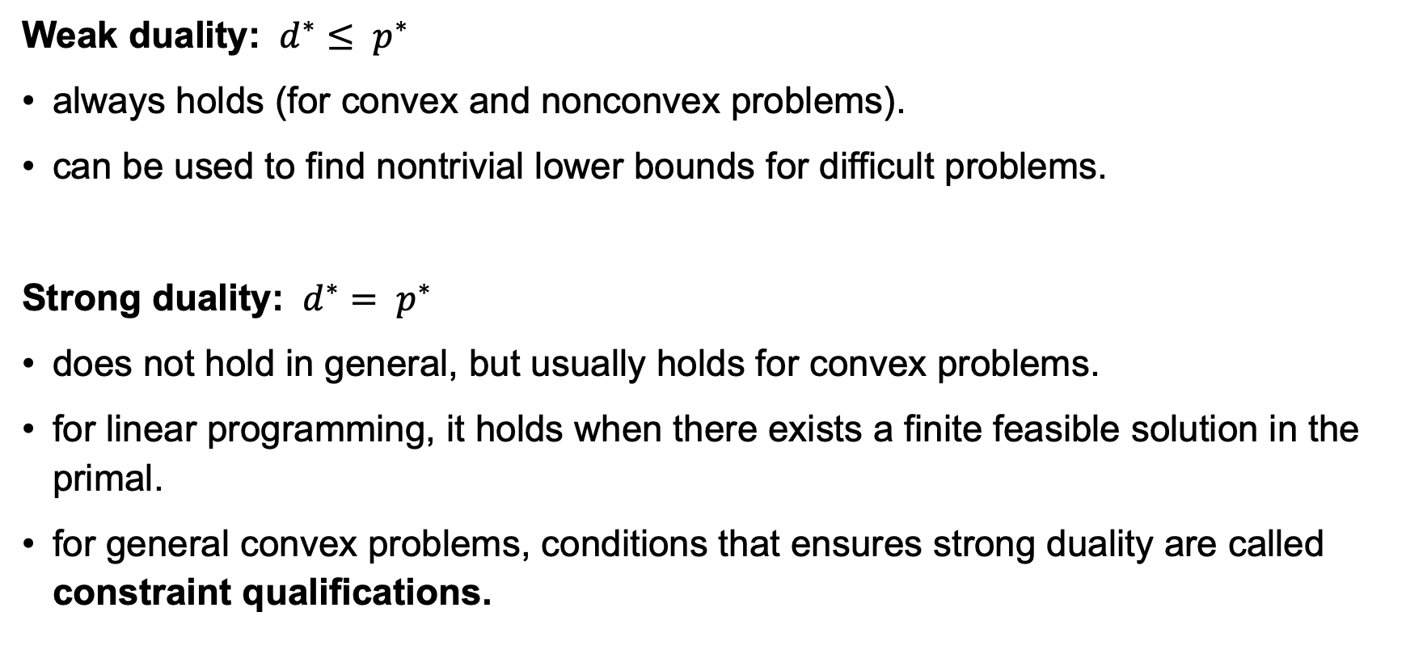
Weak and Strong Duality
Weak duality: $d^{∗}≤ p^{∗}$
always holds (for convex and nonconvex problems).
can be used to find nontrivial lower bounds for difficult problems.
Strong duality: $d^{∗}= p^{∗}$
does not hold in general, but usually holds for convex problems.
for linear programming, it holds when there exists a finite feasible solution in the primal.
for general convex problems, conditions that ensures strong duality are called constraint qualifications.

Slide 31
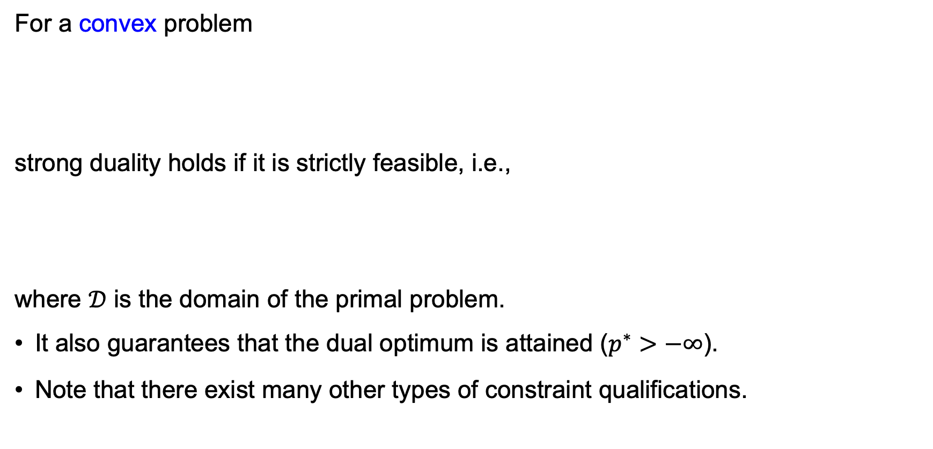
Slater’s Constraint Qualification
For a convex problem
strong duality holds if it is strictly feasible, i.e.,
where $𝒟$ is the domain of the primal problem.
It also guarantees that the dual optimum is attained ($p^{∗}>−∞$).
Note that there exist many other types of constraint qualifications.

Slide 32
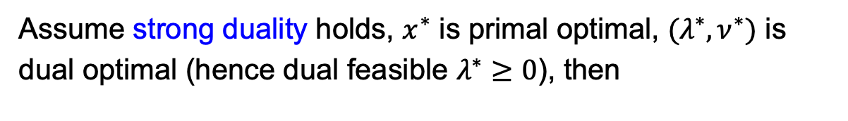
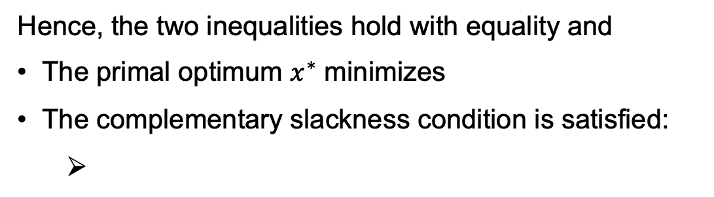
Complementary Slackness
Assume strong duality holds, $x^{∗}$ is primal optimal, $(λ^{∗},ν^{∗})$ is dual optimal (hence dual feasible $λ^{∗}≥0$), then
Hence, the two inequalities hold with equality and
The primal optimum $x^{∗}$ minimizes
The complementary slackness condition is satisfied:

Slide 33
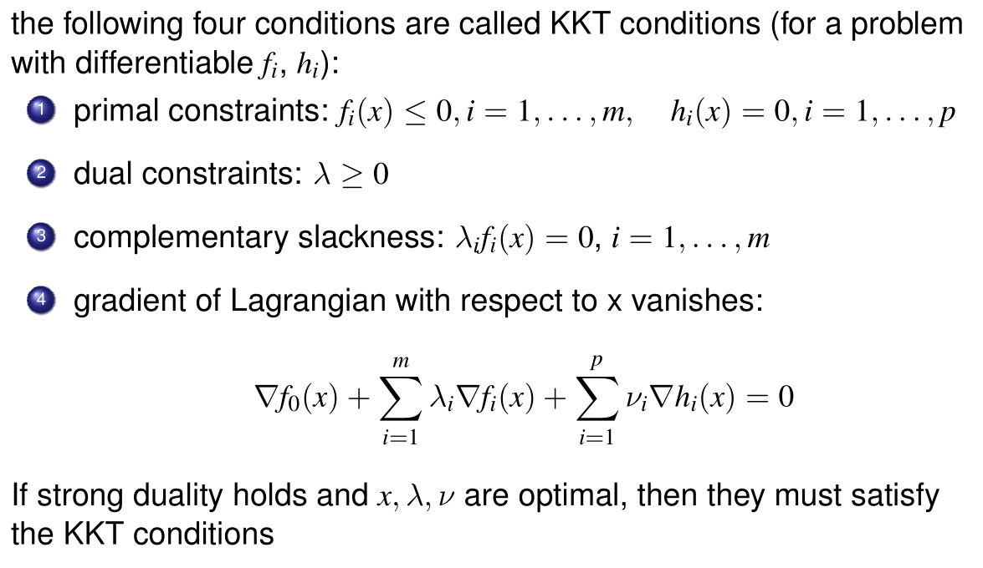
Karush-Kuhn-Tucker (KKT) Conditions
Furthermore, if the problem is convex and the strong duality holds (e.g., by Slater’s), then KKT is the necessary and sufficient condition for optimality.

Slide 34
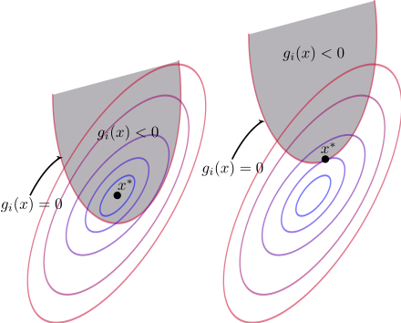
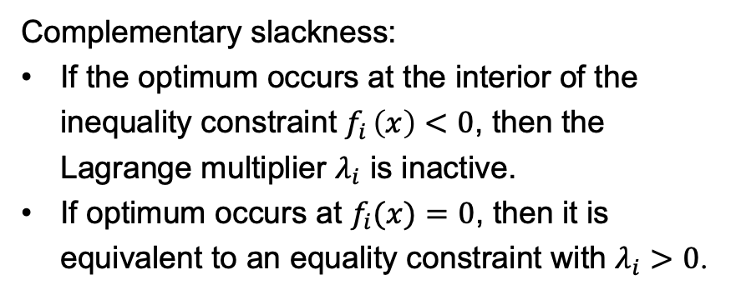
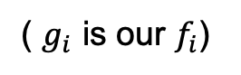
KKT Conditions – The Picture
( $g_{i}$ is our $f_{i}$)
KKT condition:
Complementary slackness:
If the optimum occurs at the interior of the inequality constraint $f_{i} \left(x\right)<0$, then the Lagrange multiplier $λ_{i}$ is inactive.
If optimum occurs at $f_{i}(x)=0$, then it is equivalent to an equality constraint with $λ_{i}>0$.
Notes:
Remind support vectors in SVM.

Slide 35
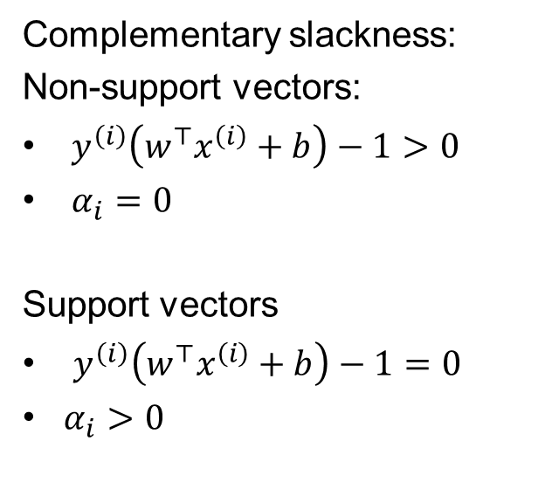
Example in SVM
Complementary slackness:
Non-support vectors:
$y^{\left(i\right)}\left(w^{⊤}x^{\left(i\right)}+b\right)−1>0$
$α_{i}=0$
Support vectors
$y^{\left(i\right)}\left(w^{⊤}x^{\left(i\right)}+b\right)−1=0$
$α_{i}>0$
Notes:
Remind support vectors in SVM.

Slide 36



Non-smooth Functions – Subgradient
Differentiable
Nondifferentiable

Slide 37




Non-smooth Functions – Subdifferential
First-order optimality condition for minimizing $F(x)$:
For constraint optimization, replace the vanishing gradient condition in KKT by:

Slide 38

Example: LASSO optimality conditions
Note:
Subgradient optimality conditions don’t lead to closed-form expression for a LASSO solution...
However they do provide a way to check LASSO optimality

Slide 39
Interior-point Methods for Convex optimization

Slide 40
Interior-point Methods
A generic and powerful approach to solve constrained nonlinear programming problems
Reliable and efficient (polynomial runtime for convex problems).
Many mature software: e.g., IPOPT (open source)
Interface to C++, Python, Julia, …
Handy to use when combined with automatic differentiation (for nonlinear functions).

Slide 41




Logarithmic Barrier
Reformulate the problem via indicator function:
where $I_{−}(u)=0$if $u≤0$; $I_{−}(u)=∞$ otherwise.
Approximation via logarithmic barrier
which is an equality constrained problem.
The decision variable needs to overcome a huge “energy barrier” to go outside the feasible region.
Idea: start with a small $t$, use the (near) optimal solution as the starting point to solve for the problem with a larger $t$.

Slide 42

Logarithmic Barrier Function
$φ(x)$ convex if $f_{i}(x)$ convex.
$φ(x)$ differentiable if $f_{i}(x)$ differentiable:
Objective function becomes

Slide 43

Dual Points – Quality of Solution
For a fixed $t$, we solve
Optimality condition
Define
Optimality condition can be viewed as the minimization condition of the following Lagrangian:

Slide 44

Dual Points – Quality of Solution
Remind the result of weak duality:
The approximation of barrier method improves with enlarging $t$.

Slide 45


Barrier Method

Slide 46


Examples
When applied to LP, comparing to the simplex algorithm, the interior-point method enjoys provable polynomial runtime.
central path for the LP
Notes:
Central path: evolves in the interior of the feasible region.

Slide 47

Primal-dual Interior-point Methods (optional)
Remind that $λ_{i}\left(t\right)=1/(−tf_{i}(x))$, the centering step in barrier methods solve a modified KKT condition
Viewing $λ_{i}(t)$ as additional variables and solving the above modified KKT equations by Newton’s methods lead to the primal-dual interior-point methods
update primal and dual variables at each iteration
no distinction between inner and outer iterations
primal-dual iterates are not necessarily feasible
usually more efficient than barrier method, but less intuitive…

Slide 48
Semidefinite Programming (Mostly Optional)

Slide 49

Semidefinite Programming (SDP) - Introduction
A generalization of linear programming to “matrix” variables $X∈ℝ^{n×n}$.
Also a convex problem, hence there exists (relatively) efficient algorithms.
Flexible for modelling, can provide approximate solutions to some very difficult problems (more in coming lectures).
Standard form of SDP
Standard form of LP

Slide 50

Positive Semidefinite Cone
Notations
$A∈ℝ^{n×n}$ is positive-definite $⇔$ $x^{⊤}Ax>0, ∀x∈ℝ^{n}\backslash \{0\}$
$A∈ℝ^{n×n}$ is positive-semidefinite $⇔$ $x^{⊤}Ax≥0, ∀x∈ℝ^{n}$
$S^{n}$ denotes the set of symmetric $n×n$ matrices ($A∈S^{n}$, then $A^{⊤}=A$, or $A_{ij}=A_{ji}$)
$S_{+}^{n}$ denotes the set of symmetric positive-semidefinite $n×n$ matrices
$S_{++}^{n}$ denotes the set of symmetric positive-definite $n×n$ matrices
The set $S_{+}^{n}$ is a convex set (apply the definition of convexity), called the positive semidefinite cone.

Slide 51



Positive Semidefinite Cone – Examples
(e.g., a correlation matrix)

Slide 52

About Semidefinite Matrix
Eigen-decomposition of a square matrix $A=QΛQ^{−1}$, where $Λ_{ij}=λ_{i}δ_{ij}$
If $A∈S^{n}$, then $λ_{i}\left(A\right)∈ℝ$, and we can choose the eigenvectors (columns of $Q$),
such that $Q^{−1}=Q^{⊤}$, or $QQ^{⊤}=Q^{⊤}Q=I$.
$Q$ is called an orthogonal matrix.
$A=QΛQ^{⊤}$
Block symmetric matrix:
Schur complement of $A$ in $U$:

Slide 53

Semidefinite Programming
Let $X∈S^{n}$. Think of $X$ as
a matrix
an array of $n^{2}$ components of the form $(x_{11},…,x_{nn})$
an object (a vector) in the space $S^{n}$
Define the inner product between matrices $C, X∈S^{n}$ as
which is a linear function of $X$.
standard form of SDP:
linear function
linear equality constraint
convex set constraint

Slide 54
Semidefinite Programming – Dual Problem
Lagrangian:
Lagrange dual:
Dual problem:
linear matrix inequality

Slide 55


SDP – Interior-point Methods
Log-barrier functions for the “inequality” constraint :
Intuition:
which penalizes the system when $λ_{i}(X)$ approaches $0$.
Gradient of the log-barrier function:
Barrier methods from previous sections apply here.

Slide 56

Examples
Eigenvalue optimization
Maximizing the smallest eigenvalue $λ_{min}(A(x))$,
where
SDP formulation:
Applications
Fast convergence of dynamical system to equilibrium:
Optimal experimental design for linear regression:
More applications in coming lectures.
Notes:
The case of experimental design considered in Boyd: $x_{i}$ can be chosen from a fixed set of $\{v_{a}\}$. Probabilistically $x_{i}=\sum_{a}{p_{a}v_{a}}$

Slide 57
Summary
Convex optimization is tractable and broadly applicable.
Consider formulating your problem to a convex optimization problem, and exploit many existing mature software (e.g., CVX in Matlab, CVXPY in Python, Convex.jl in Julia).
Duality
Dual problem provides a lower bound of the primal
Sometimes easier to handle
Sometimes provide an interesting interpretation of the primal.
Gives some implications for algorithms (e.g., KKT conditions); more to discuss in coming lectures.
Interior point method to deal with convex inequality constraints.
Semidefinite programming provides a very powerful tool to model matrix related problems.

